Slide 1

CS4157
Software Quality
Notes:
CS5707 Software Development Paradigms
John Dawson
CS5707 Software Development Paradigms
John Dawson
CS5707 Software Development Paradigms
John Dawson

Slide 2
Last Week
Software Process Models
CMM: Capability Maturity Model
ISO/IEC 12207 / 15504 / SPICE
Notes:
CS5707 Software Development Paradigms
John Dawson
CS5707 Software Development Paradigms
John Dawson
CS5707 Software Development Paradigms
John Dawson

Slide 3
Lecture Outline: Week 4 – 13th Feb
Project Management: an Overview / Review
Notes:
CS5707 Software Development Paradigms
John Dawson
CS5707 Software Development Paradigms
John Dawson
CS5707 Software Development Paradigms
John Dawson

Slide 4
Why Project Management?
Project Management is an essential component of good quality processes – required for good quality products
Project Management is a key component of 5 out 6 of the CMM Level 2 KPAs, and also of many higher level KPAs
Project Management is a key component of many of the SPICE processes, including all processes in the Management Process Category
Notes:
CS5707 Software Development Paradigms
John Dawson
CS5707 Software Development Paradigms
John Dawson
CS5707 Software Development Paradigms
John Dawson

Slide 5
What is a Project?
A task or undertaking
Has a specific, usually technical, objective
Is a usually a temporary endeavour
Is a collaborative effort
Is subject to conflicting constraints:
  Budget / Money
  Deadlines
  Scope: Functionality / Features
  Quality: Reliability / Performance etc.
Notes:
CS5707 Software Development Paradigms
John Dawson

Slide 6
What is Project Management?
Taking responsibility – for a project
Being accountable – to your manager(s), to your customer(s)
Managing other people
Manager(s)
Customer(s)
Project Manager
Staff
Staff
Sub-Contractors
Notes:
CS5707 Software Development Paradigms
John Dawson

Slide 7
Project Management: Planning & Iteration
Project planning: make a list of jobs to be done
At first, some will be “fuzzy” – not well defined
Over iteration, “ fuzzy” jobs (hopefully) become better defined and the plan improves, incrementally
“Concrete” jobs may be estimated; “fuzzy” jobs: “guessimated”
“Fuzzy” jobs “Concrete” jobs
Notes:
CS5707 Software Development Paradigms
John Dawson

Slide 8
Project Management as a Discipline
Project management methods:
  PRINCE – Projects IN Controlled Environments
  PMBOK – Project Management Body Of Knowledge
  10 steps – A pragmatic guide
Project management planning tools:
  Microsoft Project
  Project-Open
  Spreadsheet
Some project management concepts:
  Process, Phase, Increment, Design, Risk, Plan, Scope, Manage, Control, Evaluate ...
Notes:
CS5707 Software Development Paradigms
John Dawson

Slide 9
Project Management: Ten Steps
10 steps: The Silver Bullet – Fergus O’Connell
A structured approach to project management, pragmatic and fairly non-specific
Visualise the goal
Make a list of jobs to be done
There must be one leader
Assign people to jobs
Manage expectations, allow a margin for error, have a fallback position
Use an appropriate leadership style
Know what’s going on
Tell people what’s going on
Repeat 1- 8 … until
You’ve achieved your goal; celebrate
Notes:
CS5707 Software Development Paradigms
John Dawson

Slide 10
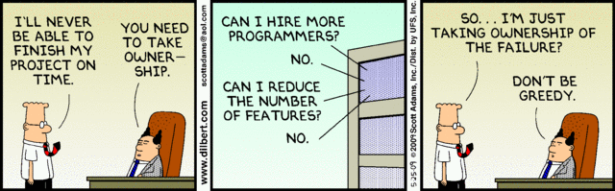
Dilbert on Project Management

Slide 11
Next Week
Software Testing
Notes:
CS5707 Software Development Paradigms
John Dawson
CS5707 Software Development Paradigms
John Dawson
CS5707 Software Development Paradigms
John Dawson

Slide 12
Reading
Assessable paper: due week 6
R. A. Khan and R. K. Choudhary (2011), Software Testing Process: A Prescriptive Framework
General reading
Sommerville, Chapter 5 (recommended text)
Notes:
CS5707 Software Development Paradigms
John Dawson
CS5707 Software Development Paradigms
John Dawson
CS5707 Software Development Paradigms
John Dawson

